Slide 1
Food Sales Analysis
Meera Hari
Richa Kumari

Slide 2
Contents
❶ Understanding the Business Model
❷ Introduction to the dataset
❸ Insights to be found out
❹ EDA – Data Cleaning and Preprocessing
❺ Key Findings
❻ Dashboard Building

Slide 3
Understanding the Business Model

Slide 4
Understanding the Business Model
□ E-commerce industries has been one of the major growing sectors of the millennial
□ Ranging across variety of products from electronics, accessories, fashion to food, e-commerce has become the most convenient platform for shopping all over the world
□ Sales management has gained importance to meet increasing competition and the need for improved methods of distribution to reduce cost and to increase profits. Sales management today is the most important function in a commercial and business enterprise.
□ Analyzing the sales history of different products is crucial for the sector to understand the consumer interests and retain their presence and grow the business

Slide 5
Introduction to Data

Slide 6
Data Set
□ The Dataset consists of 65282 records of sales parameters of various food products
□ Overall we have 20 columns like Customer keys, Invoice date, Delivery Date, Item Number, Item Name, Price details of the item, Discount Applied, Profit made etc..
□ CustKey- Unique ID numbers given to each customer
□ Invoice Date- Date on which the Invoice has been generated
□ Invoice number- The unique number generated against each bill
□ Item Class- The category number assigned to the items.
□ Item- Names of all the products to be analysed.
□ Line Number
□ Order Number- Number generated against each item ordered
□ Promised Delivery Date- Date on which the order is to be delivered

Slide 7
Data Set
□ Sales Price- Selling price of each item
□ Sales Cost amount- Total Cost Price for the quantity of items sold.
□ Sales Quantity- No of the particular item sold
□ Sales Amount = Total sales amount generated= Sales Price * Sales Quantity
□ Sales amount based on List Price= Total Sales amount on the basis of Manufacturer suggested Selling Price
□ Sales Margin Amount= Profit made on each item = Sales Amount- Sales Cost Amount
□ Discount Amount= Discount applied on the Selling price of items= Sales Amount based on List Price- Sales Amount
□ Sales Rep- Unique ID for the sales representative who sold the items
□ U/M- Unit of measure of the items sold

Slide 8
Insights to be found out

Slide 9
Insights to be found out
□ Extract the information from the dataset, do the necessary transformation and analyze the data to obtain the Sales Trend : Year wise, Month wise, Year-month wise
□ Understanding the relationship between various attributes and come up with insights on the various sales Parametric.

Slide 10
EDA – Data Cleaning and Preprocessing (Using SQL)

Slide 11
EDA – Data Cleaning and Preprocessing
Step 1) CHECKING THE NO OF ROWS AND COLUMNS
The data has 65282 rows and 20 columns
Step 2) CHECKING THE DATA TYPE OF THE COLUMNS
All numerical columns are of 'float' datatype, the categorical columns are of nvarchar type and the date columns are of date time type
Step 3) CHECKING MIN AND MAX VALUES IN EVERY COLUMNS TO CHECK ANY OUTLIERS
list Price per item : 0
Total Sales Amount : 200
Total Sales Amount Based on List Price(MSRP) : 0
Discount Amount : 255820

Slide 12
EDA – Data Cleaning and Preprocessing
Sales Cost Amount : 0
Sales Price per item : -5000
Sales Quantity : -1
Sales Margin Amount(Profit): 3932.93
□ The sales price of -5000 corresponds to the sales quantity of -1, which means that the item was returned and hence it is to be deleted from the sold stock.
□ Negative Profit actually means loss
MAX VALUES:
List Price per item: 2760.7
Sales Cost Amount: 366576

Slide 13
EDA – Data Cleaning and Preprocessing
Sales Price per item: 6035
Sales Quantity: 16000
Sales Margin Amount(Profit): 188800
Total Sales Amount: 555376
Total Sales Amount Based on List Price(MSRP): 632610.16
□ All the values seem to be in range as there is no particular threshold for the maximum value as the dataset consists of various items with different prices
Step 4) HANDLING MISSING VALUES
□ In Excel format, we came to know that the column Item Class, Item Number, Discount and Sales Price per Item has Null Values
□ Since Item Number and Item Class are not necessarily affecting the profit or Sales Amount, we can ignore it.

Slide 14
EDA – Data Cleaning and Preprocessing
□ Since we have Sales Price row as null, Updating the sales price column with the average SP of Monarch Manicotti.
□ Discount amount null value has been replaced by formula (List Price(MSRP)-Total Sales Amount)
Step 5) CHECKING THE NO OF RECORDS WITH ZERO SALES QTY
One record having Sales quantity as Zero, so we ignored it
Step 6) CHECKING IF DATEKEY AND INVOICE DATE ARE IDENTICAL
□ DateKey and Invoice Date columns are identical and hence one column can be dropped
Step 7) DROPPING THE UNECESSARY COLUMNS
□ Dropped Item Class, Item Number and U/M
□ Finally we have a dataset with 65281 rows and 16 columns with no null values

Slide 15
Visual Analytics and Key Findings

Slide 16
Visual Analytics using Power BI
The cleaned data from SQL was imported into Power BI for Data visualization.
A calendar table has been created and connected to the original dataset to analyze the yearly and monthly sales trend.
A separate measures table has been created to accommodate all the new measures added to visualize the data.
Visual Insights have been gathered with the use of line graphs, cards. Pie charts , bar charts and waterfall graphs

Slide 17
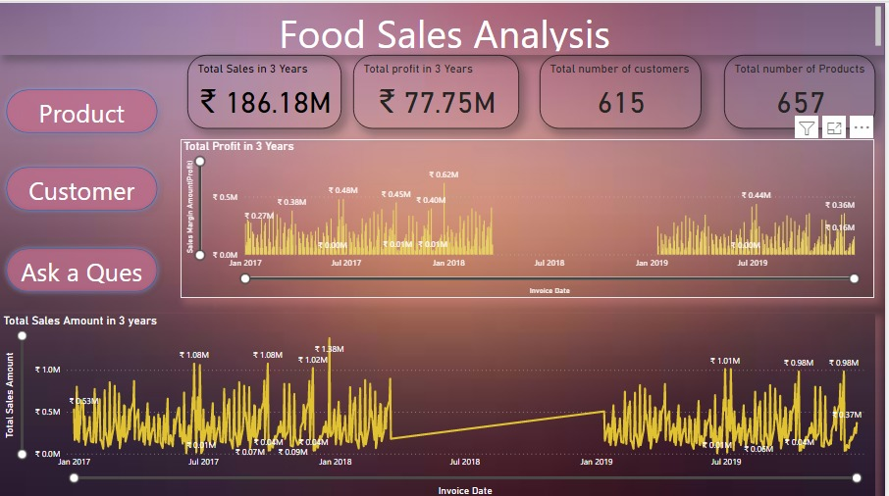
Visual Analytics and Key Findings- General Analysis

Slide 18
General Analysis- Insights
Total Sales in 3 Years $ 186.18 M
Total Profit in 3 Years $ 77.75 M
Total Number of Customers 615
Total Number of Products 657
Over a time span of 3 years (Jan 2017-Dec 2019), 657 unique products were sold over to 615 customers and in the process a total of $186.18 million was the Sales amount generated and a profit of $ 77.75 million was achieved.

Slide 19
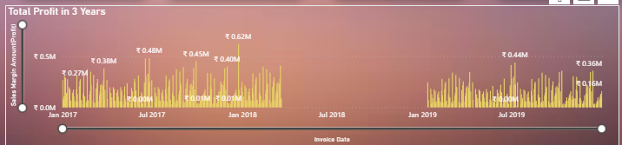
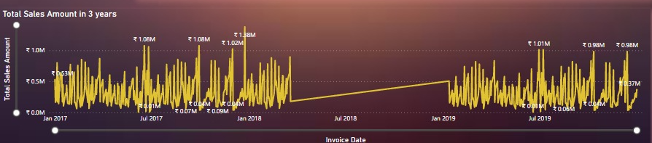
General Analysis - Insights
The above two graphs clearly depict the drastic slump in sales during the period
March 2018 to Dec 2018.

Slide 20
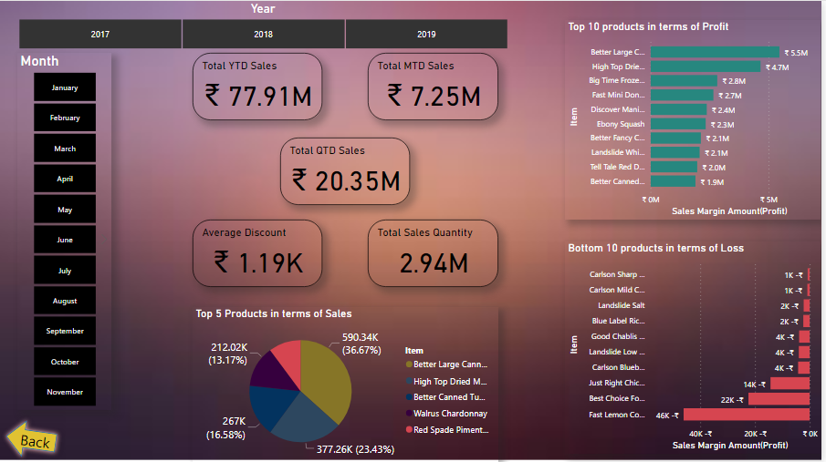
Visual Analytics and Key Findings-Sales Analytics

Slide 21
Sales Analytics- Insights
The Maximum Sales Amount generated and Profit made year is 2017.
September seems to be a month of significant increase in shopping generally.
The 2018 sudden slump after March seems to be the contributing factor for the highest sales in March 2018.
Year | Total Sales Amount | Month of max sales Amount | Quarter of max sales amount | Max profit made
2017 | 87.46 M | September(8.79M) | Q1 (23.43M) | 37.42M
2018 | 20.82M | March(7.63M) | Q1(20.82M) | 20.82M
2019 | 77.91M | September(7.68M) | Q3(21.42M) | 31.18M

Slide 22
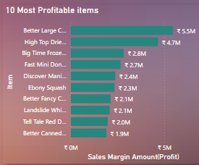
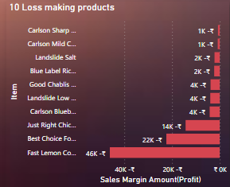
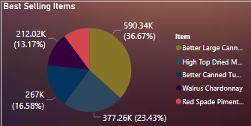
Sales Analytics- Products
The highest selling products seems to be same throughout the years- Better Large canned Shrimp, High top dried mushrooms, Better Canned Tuna oil, Walrus Chardonnay, Red spade Pimento loaf.
Walrus Chardonnay and Red spade pimento loaf still are not making enough profit even being a large selling product.

Slide 23
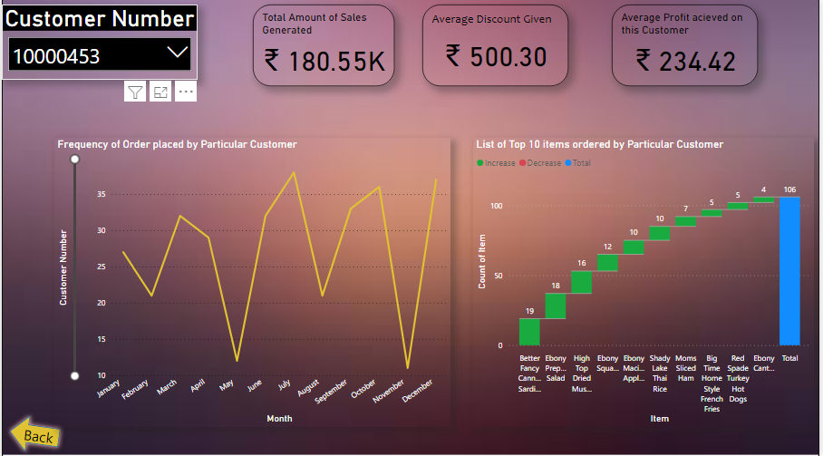
Consumer Behavior
Consumer’s shopping behavior across the months has been shown with the help of a line graph and customer key
The top products ordered, Sales amount generated, Average discount applied and Average profit gained also is generated for a particular customer with the selection of the customer key.

Slide 24
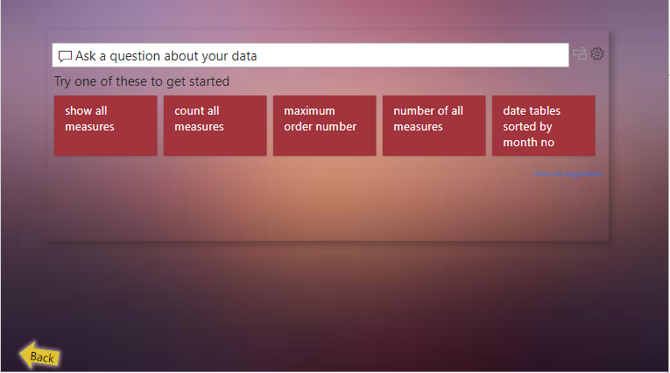
Visual Analysis- To know more
A provision to answer any additional queries has been added to the Dashboard pages.

Slide 25
Conclusions
The Sales had hit a slump during the period March 2018- Dec 2018
The Maximum Sales Amount generated and Profit made year is 2017
September seems to be a month of significant increase in shopping generally
The 2018 sudden slump after March seems to be the contributing factor for the highest sales in March 2018
The highest selling products seems to be same throughout the years- Better Large canned Shrimp, High top dried mushrooms, Better Canned Tuna oil, Walrus Chardonnay, Red spade Pimento loaf
Walrus Chardonnay and Red spade pimento loaf still are not making enough profit even being a large selling product
Each individual customer has a varied purchasing trend

